Slide 1
Session 1
An Introduction to Web Services

Slide 2
Session Objectives
Discuss distributed computing
Explain web services and their characteristics
Discuss the generic architecture of web services
Describe the life cycle of a web service
Identify the requirements for a web service
Explain the working of a web service
Discuss the advantages and disadvantages of web services

Slide 3
Component Architecture
Components
User submits
parameters
Method 1……
Appropriate
Method called
Method 2……
Application
Returns
the result

Slide 4
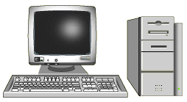
Computing Over the Years (1)
Application
Database
Stand-alone Computers

Slide 5

Computing Over the Years (2)
Client-Server Computing
Server
PC
Clients: Smart terminals

Slide 6
Distributed Computing
Distributed Computing
Component C
Component D
Network
Component B
Component E
Component F
Linux OS
Component A
Windows OS
Smart terminals

Slide 7
Distributed Component Architectures
The three main Distributed Component Architectures are:
CORBA
Developed by OMG
DCOM
Developed by Microsoft
RMI
Developed by SUN. Uses CORBA for Heavy-Duty Distributed Systems

Slide 8


Inter-Module Communication
Inter-Module communication needs:
1. Set of rules for communication
2. Standard Language for interfaces
3. Interfaces for the modules
Application developed using C#
Application developed using VB.net

Slide 9
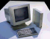
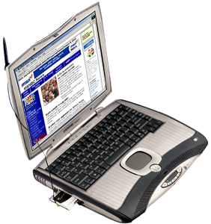
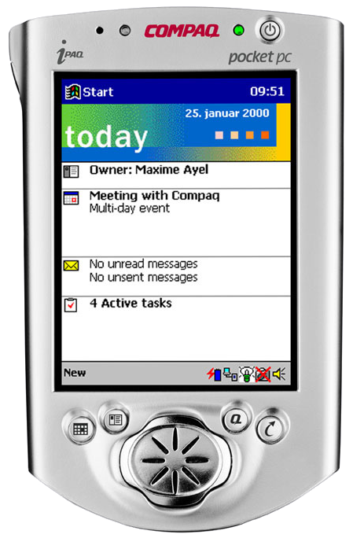
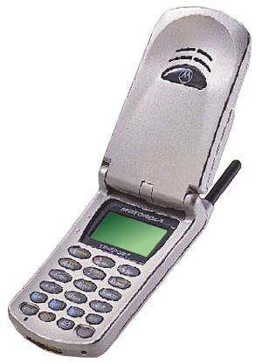
Web-based Applications
Must be simple, self explanatory and easy to use
Services Offered
e-mail, browsing, searching the net, chat applications
Devices Used to Access the Web

Slide 10

Web Services
Web Services: Internet based modular applications
Network
Web Service
Network may be LAN, WAN, MAN or Internet

Slide 11

Web Services Solutions
Two of the most popular Web Services Solutions
SUNTM OPEN NET ENVIRONMENT (SUN ONE)

Slide 12

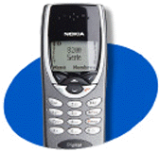
Web Service Example
Another Web
Service
EMI Calculator Web Service
Loan Application Using
Web Service
Running on

Slide 13
Characteristics of Web Services
Accessed over the web
Should be registered
Supported by loosely coupled applications
Has a service interface
Web Services
Integrated Just In Time
Uses standard
web protocols
Uses XML

Slide 14
Important Components
Service
Provider
Publish
Bind
Service
Registry
Service
Broker
Service
Requestor
Find

Slide 15
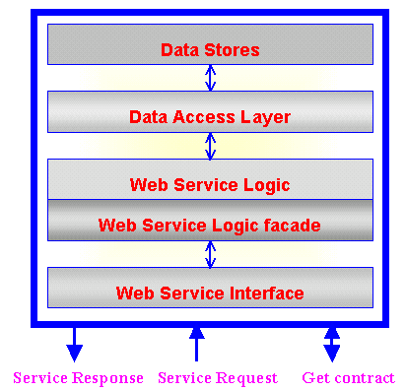
Web Services: Generic Architecture

Slide 16
Life Cycle
6. Unpublished the web service when not needed
5. Invoke the web service
4. Search for the web service
3. Publish the web service on the Internet or Intranet
2. Define service interface, invocation methods for the web service
1. Create a web service

Slide 17
Requirements for a Web Service
XML: Represent data in a standard format
SOAP: Common extensible message format
WSDL: Common, extensible, service description language
DISCO: Defines the format in which data is stored
UDDI: Maintains registries storing information about
service providers and their services

Slide 18
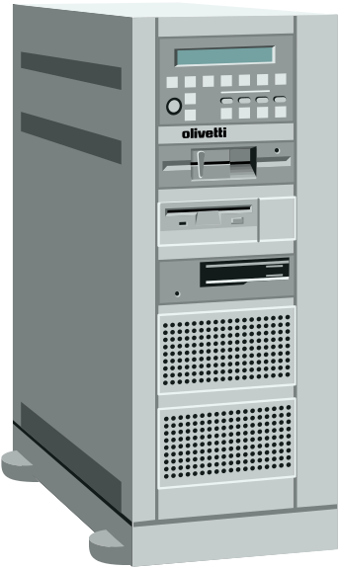
Working of a Web Service
Service Description
Get Type info
(XML Schema)
Parameters
Soap Protocol
XML over HTTP
Return Value
Web Server
(With Web Service)
Client Application

Slide 19
Accessing Web Services over HTTP
HTTP GET operation
HTTP POST operation
SOAP

Slide 20
Advantages of Web Services
Organization A
Organization B
Business Process
Web Service
Cross business integration
Improved efficiency
Closer customer relationships
Facilitates just-in-time integration
Reduces complexity
Legacy applications
Notes:
Next we move on to the ‘Orchestration’ layer.
To understand this, let us first consider an Organization, say ‘A’. It has a set of business processes, and a set of web services, which are used within the organization itself. Similarly, there may be another organization, say ‘B’, which has a similar scenario. Let us assume that there may be some business processes or web services that each uses from the other.
In such a case, processes and web services run within the organizations as well as between the organizations. There maybe a variety of software systems in the organizations, as well as multiple hardware platforms. In addition to this, there maybe multiple such customer, partner and service provider locations. In such a case there is a need for some tool that is capable of handling the orchestration within as well as between these.
BizTalk Server 2000 provides these tools for this orchestration.

Slide 21
Constraints
Businesses not willing to expose the functionalities
The only technology that forms the base is XML, that means we cannot do without XML
The cost involved is very high

